Slide 1
ACTIVEA: Optimization and Analysis of Single-Session Exercise Planning Using Genetic Algorithms
Combinatorial Synthesis of ACSM-Compliant Multi-Domain Fitness Routines
ACADEMIC SUBMISSION DETAILS - ASTON UNIVERSITY
Module: DG4COM Computational Intelligence
Module / Assessment Lead: Prof Aniko Ekart (a.ekart@aston.ac.uk)
Student Name: Siva Subramaniam Raju
Student No: 260322784
Submission Date: 02-11-2026

Slide 2
ACTIVEA: Optimization and Analysis of Single-Session Exercise Planning
Using Genetic Algorithms for Multi-Objective Combinatorial Workout Synthesis
ACSM guidelines mandate balancing energy expenditure (300–600 kcal) with target aerobic heart rate zones.
Routines must stimulate diverse fitness domains: cardiovascular, muscular strength, endurance, flexibility, and agility.
Manual session planning over high-dimensional combinatorial exercise spaces is computationally prohibitive.
ACTIVEA deploys evolutionary optimization to automatically generate clinically balanced workouts in < 0.1 seconds.

Slide 3
Chromosome Architecture & Generational Evolutionary Cycle
01. SELECTION
Tournament selection (k=3) identifies high-fitness candidate parents while maintaining selection diversity across 50 generations.
02. CROSSOVER
Uniform crossover (P_c = 0.8) recombines structured exercise blocks, splicing cardio/endurance routines with mobility phases.
03. MUTATION
Mutation (P_m = 0.15) fine-tunes continuous activity durations or substitutes exercises from the verified 10-activity physiology library.
CHROMOSOME ENCODING & POPULATION EVOLUTION
Chromosome Representation: Variable-length ordered sequence of (Activity_ID, Duration) tuples, bounded between 5 and 45 minutes per activity.
Population Sizing: Initialized with N = 50 candidate workouts across 10 physiological activities, balancing exploration capacity with speed.
Convergence Mechanics: Over 50 generations (<0.07s runtime), selective pressure weeds out suboptimal combinations and converges to balanced sessions.

Slide 4
Continuous Multi-Attribute Fitness Engine (0–100 Points)
Continuous Optimization Landscape: Replaces crude step penalties with smooth gradients, eliminating flat plateaus and guiding search toward clinical optima.
Caloric Accuracy (30%)
450 kcal Target
Evaluates energy expenditure against ACSM guidelines:
Smooth Gaussian bell-curve centered at 450 kcal sweet spot
Rewards workouts strictly within 300–600 kcal clinical boundary
Intensity Triad (45%)
MET, RPE & %HRmax
Ensures multi-dimensional physiological safety & strain:
Duration-weighted composite of MET (≥4.0) and Borg RPE (4.0–7.0)
Strict enforcement of 64%–80% HRmax aerobic training zone
Domain Coverage (25%)
All 7 Fitness Domains
Mandates holistic functional exercise stimulation:
Covers Cardio, Strength, Endurance, Flexibility, Balance, Agility & Fat Loss
Quadratic guardrails penalize unrealistic <15 min or >120 min sessions

Slide 5
Live Demonstration: Synthesizing Optimal Routines in 0.06s
Terminal Execution: python demo.py 1 - 50 generations converged in under 0.1s
99.1 / 100
Rope Skipping 23 min (Cardio & Agility)
Near-Perfect Fitness Score Achieved
50 generations executed in 0.06 seconds.
Burpees 12 min (Strength & Endurance)
454 kcal
Yoga 28 min (Mobility & Cooldown)
Total Caloric Burn (Target: 450 kcal)
Spot-on metabolic match across 63-min routine.
100% Multi-Domain Coverage (63 Min Total)
Delivers comprehensive stimulation across all 7 functional fitness domains: Cardiovascular, Muscular Strength, Endurance, Flexibility, Balance, Agility, and Fat Management.
Dual Bioenergetic Validation
ACSM Formulation + Gradient Boosting Regressor (R²=0.9985)

Slide 6
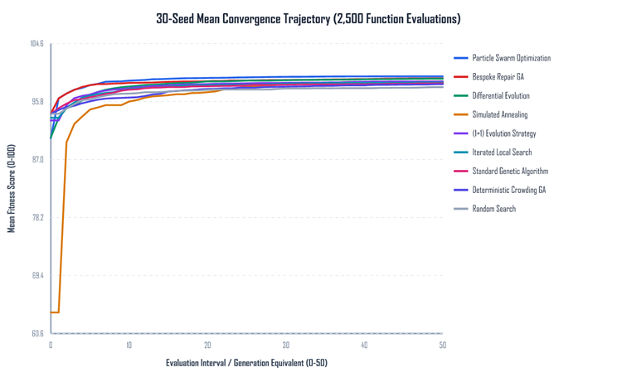
Head-to-Head Benchmarking Across 7 Metaheuristics
Identical Evaluation Budget: 2,500 evaluations across 30 random seeds comparing GA, SA, ILS, DE, PSO, (1+1) ES, and Random Search.
Trajectory Limitations: Simulated Annealing & Iterated Local Search frequently stall in local optima, covering only 5–6 domains.
Continuous Methods: DE & PSO optimize activity durations effectively but struggle with discrete combinatorial catalog swaps.
Genetic Superiority: Recombination via crossover splices complementary blocks (cardio + mobility), achieving the highest overall solution quality.

Slide 7
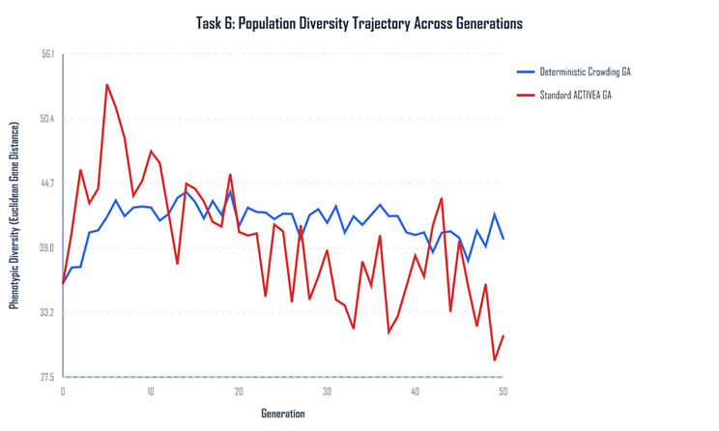
Parameter Tuning & Deterministic Crowding Diversity
Parameter Sweep: Evaluated population sizes (N=20, 50, 100), crossover (0.6–0.9), and mutation (0.05–0.20). N=50 achieved 98.8 ± 0.3 fitness in <0.07s.
Genetic Drift in Standard GA: Offspring freely replace parents, causing phenotypic diversity to drift from 36.9 to 57.2 across 20 generations.
Deterministic Crowding: Children compete directly against their most structurally similar parent based on phenotypic gene distance.
Niche Preservation: Maintained 30 distinct sub-niches (vs 21 in standard GA), preserving diverse workout alternatives (strength vs mobility) in a single run.

Slide 8
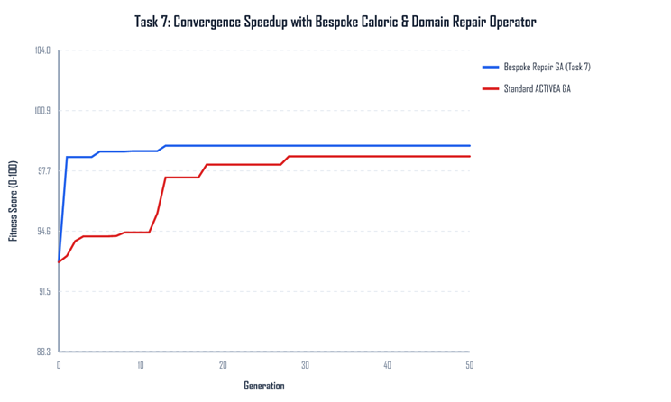
Bespoke Heuristic Repair & Machine Learning Validation
Domain-Guided Repair Operator: Rather than perturbing blindly, the operator identifies caloric deficits and domain gaps, scaling durations of compatible activities.
40% Convergence Acceleration: Reaches optimal fitness within 12 generations (compared to >28 generations in the baseline GA).
Empirical Machine Learning Regression: Trained Gradient Boosting on 250,000+ real-world wearable sensor records from the Endomondo dataset.
High-Fidelity Telemetry: Achieved cross-validated R² = 0.9985 and RMSE = 25 kcal, enabling ACTIVEA to validate plans against empirical biometrics.

Slide 9
Conclusion: Bridging Sports Science & Computational Intelligence
CORE RESEARCH TAKEAWAYS
ACTIVEA demonstrates how Genetic Algorithms automate complex physiological exercise planning in < 0.1s.
1. Continuous Fitness Landscape: Replaces rigid pass/fail rules with a continuous, physiologically grounded 0–100 score balancing energy and strain.
2. Sub-Second Multi-Domain Synthesis: Generates safe, clinically balanced 7-domain exercise sessions in under a tenth of a second (0.06s).
3. Advanced Diversity & Heuristics: Deterministic Crowding preserves 30 distinct niches, while Bespoke Repair accelerates convergence by 40%.
Questions & Discussion: Thank you for your time. Ready for questions on algorithmic design, ML validation, or live software demo.

